Slide 1

JIT Compilation

Slide 2
Module Overview
JIT Compilation
Native vs. Managed Compilation
Managed Execution Phases
JIT Compilation
What’s new in NGEN 4.0?
When to use NGEN?

Slide 3
Running Code
Behavior in Windows 2000
Legacy entry point mscoree!CorExeMain gets used
Behavior in Windows XP
The operating system loader checks for managed modules by examining a bit in the common object file format (COFF) header
The bit being set denotes a managed module
If the loader detects managed modules, it loads mscoree.dll, and clr!CorValidateImage and clr!CorImageUnloading notify the loader when the managed module images are loaded and unloaded
clr!CorValidateImage performs the following:
Ensures that the code is valid managed code
Changes the entry point in the image to an entry point in the runtime
On 64-bit Windows, _CorValidateImage modifies the image that is in memory by transforming it from PE32 to PE32+
not presented
Notes:
Running Code
The common language runtime provides the infrastructure that enables managed execution to take place as well as a variety of services that can be used during execution. Before a method can be run, it must be compiled to processor-specific code. Each method for which Microsoft intermediate language (MSIL) has been generated is just-in-time-compiled (JIT-compiled) when it is called for the first time, and then run. The next time the method is run, the existing JIT-compiled native code is run. The process of JIT-compiling and then executing the code is repeated until execution is complete.
During execution, managed code receives services such as garbage collection, security, interoperability with unmanaged code, cross-language debugging support, and enhanced deployment and versioning support.
In Microsoft Windows XP, the operating system loader checks for managed modules by examining a bit in the common object file format (COFF) header. The bit being set denotes a managed module. If the loader detects managed modules, it loads mscoree.dll, and _CorValidateImage and _CorImageUnloading notify the loader when the managed module images are loaded and unloaded. _CorValidateImage performs the following actions:
1. Ensures that the code is valid managed code.
2. Changes the entry point in the image to an entry point in the runtime.
On 64-bit Windows, _CorValidateImage modifies the image that is in memory by transforming it from PE32 to PE32+ format.

Slide 4
Native compile vs Managed compile
Simplified view of native code compilation
Notes:
A simplistic look at how native code is compiled in to static binaries, note that type describing information is largely tossed out.
For native code, some type describing information is preserved in symbolic information for debugging purposes later on and exported functions are visible in the export table, imported functions are available in the import table. In a sense symbols are pulled out of the recycle bin and stuck up on the symbol server.
Point is that the final deployable binary here pretty much contains only machine language representation of the original code.

Slide 5
Native compile vs Managed compile
Simplified view of managed code compilation
Notes:
We can see that here the type describing information is preserved and used at runtime, the compiler generates IL code that is packaged (and versioned) in the assembly for deployment. Machine language is put off until the runtime. We will talk more about machine language generation and runtime issues in next module.
MAIN point: Managed binaries keep all sorts of information traditionally thrown out by the compiler and linker, as well as the MSIL representation rather than machine language representation of the code.
This change in behavior is can also provide additional security to the CLR runtime environment. The CLR is responsible for dynamically compiling the assembly instructions at runtime and for checking the assembly for security issues, and other things, before any code is executed.

Slide 6
Managed Execution Phases
Phase
.NET Source code
.NET Source code
Compile Time
Compile
IL and Metadata
IL and Metadata
IL and Metadata
Run Time
JIT (CLR)
Native Code
Native Code
Notes:
Show ILDASM demo
Show Demo\CLRInit\Headers\ildasm.txt

Slide 7
JIT Compilation
What does JIT do?
Checks if function is called 1st time
JIT compiles IL code to native code if true
Stores native code in memory
Updates MethodDescriptor field
Reference updated to point to memory location of native code
not presented

Slide 8
Managed Execution
JIT Compilation
MyModule::Main
First call?
No
Retrieve address of native code from MethodDesc
Yes
CILJit::compileMethod (x86)
PreJit::compileMethod (x64)
[verifies and compiles the IL]
Execute the native code
Execute the native code
Native code, GCInfo, EH data,etc.
Store native code in memory
Store the address in MethodDesc
Notes:
8

Slide 9
MethodDescriptor
Contains implementation of a managed method
Generated as part of the class loading procedure
Initially points to IL Code
Can be determined during debugging
!SOS.DumpMD <MethodDesc address>
0:004> !dumpmd 009969a8
Method Name: MyApp.MainForm.menu_Click(System.Object, System.EventArgs)
Class: 00cd5c0c
MethodTable: 00996ad4
mdToken: 0600028d
Module: 00992c3c
IsJitted: no
CodeAddr: ffffffff
Transparency: Critical

Slide 10
Managed Execution
Assembly Loading and Initialization
MSCoreEE.dll is loaded
Process starts and loads the .NET Framework
Process Main thread starts executing
by calling _CorExeMain
Initializes CLR
ClassLoader is called
Reads MetaData tables
Execute Main
Build InMemory representation
JIT compile the Main method
MethodTable & EEClass
Notes:
10

Slide 11
Demo: JIT Compilation
!dumpmd –mt
bp cmdStartJit_Click
Notes:
1. Open Demos\bin\Debug\NetDebugDemos.exe. Select Module 2: Setting Managed Breakpoints from the dropdown
list and click Go. The DebugBreak will hit and WinDbg will spawn and attach.
What we want to do here is find out whether NetDebugDemos.MyObject.JitterBug() has been JIT-Compiled yet.
Actually, it hasn’t, as the DebugBreak hit before the method could be JIT-compiled. Let’s prove it:
a. !DumpHeap –stat Find the instance of NetDebugDemos.MyObject. Copy it’s MT (e.g., 0x00957b54)
NOTE: In 4.0, you can use !DumpHeap -stat -type NetDebugDemos to list summary all
objects belonging to namespace NetDebugDemos.
b. !DumpMT -md 0x00957b54 Find the MD address of NetDebugDemos.MyObject.JitterBug() (e.g.,
0x00957a90)
c. !DumpMD 0x00957a90 Note the IL RVA – that means it hasn’t been JIT-compiled yet.
NOTE: In 2.0 and 4.0, your output will show m_IsJitted: No instead of IL_RVA.
2. Press g Method Has Been Called is commented in the debugger, and it breaks in.
3. Repeat the !DumpMD command to see that the method now has a Method VA instead of an IL RVA. This is
confirmation the method has been JIT-compiled and executed.

Slide 12
JIT Performance Counters - % Time in Jit
% elapsed time in JIT compilation since JIT started
Updated at the end of every JIT compilation phase.
A JIT compilation phase occurs when a method and its dependencies are compiled.
A value > 5% can indicate a problem
Is Ngen an option?
http://msdn.microsoft.com/en-us/magazine/cc163610.aspx
Do you use multiple AppDomains?
loading assemblies as domain neutral can help
Minimize the classes and assemblies within code path
Use code coverage to determine these components.
See .NET Framework Usage Performance Rules/DA0009

Slide 13
.NET Decompilation
Managed decompilers
Output source code and IL
Source output available in multiple languages
Obfuscation can make it more difficult to decompile source code
Many different options
ILDASM (Microsoft)
ILSpy
Reflector
Salamander
Dis#
Decompiler.NET
Telerik - JustDecompile

Slide 14
PreJit / NGEN
.NET 2.0 - 3.5
Ngen is calling a Service (LocalSystem).
This service compiles the image within background.
Support compilation of all dependent DLLs and update functionality
Metadata is now included within created dll/exe
mscorsvw.exe
C:\WINDOWS\assembly\
NativeImages_v2.0.50215_32
\MyExe\MyExe.exe
Ngen MyNiceExe.EXE
JIT
Notes:
NGen also improves the overall memory usage of the system by allowing different processes that use the same assembly to share the corresponding NGen image among them, as shown in Figure 1. This can be very useful in both client and server scenarios in which the total memory footprint must be minimized. A classic example is the Terminal Services scenario in which a large number of users might be logged in and running the same application at the same time. If you're building libraries or other reusable components, you may also want to use NGen so that applications using your components can share the generated code pages.

Slide 15
NGEN 4.0
What‘s New?
Side by Side support
Located in folder Framework\v4.0.xxxxx
Supports .NET 4.0 and .NET 2.0 assemblies
Generates 2.0 image
ngen.exe install <2.0 assembly>
Generates 4.0 image
ngen.exe install <2.0 assembly> /ExeConfig:<Path to a 4.0 EXE>
OR
ngen.exe install <2.0 EXE with a config file that indicates 4.0 as the preferred runtime>

Slide 16
NGEN 4.0
Target Patching
In .NET 2 - 3.5, if Assembly Y depends on X then CLR re-ngen Y for any change in X, because
Y may inline methods from X
Y may use fields in X’s classes (layout of classes might change)
Y may derive X’s classes (layout of classes might change)
BUT ~half of changes only modify bodies of large methods
Large methods not inlined cross-assembly
No need to re-NGEN
if only function bodies changed (unless function prototype changed)
Works great for QFEs and GDRs (small security fixes)
Unlikely to work for a service pack

Slide 17
NGEN 4.0
Additional Improvements
NGEN in parallel & speeds up substantially
7% on a low end system (1 hyper-threaded core)
30% on a middle system (1 CPU, 2 core)
Typical of new laptops
50% on a high end system (2 CPU, 4 core)
Typical of new desktops
Only used for Synchronous NGEN (e.g. when installing)
Some other regressions in NGEN performance
Example: ILStubs generates IL at NGEN time, speeding up runtime, but slowing NGEN
Overall synchronous NGEN is about the same on low end, noticeably faster on mid or high
Much faster app and framework install

Slide 18
.NGEN 4.0
Priotization of NGEN
Priority 1 images compiles on all cores
ngen.exe install /queue:1 <MyImportantAssembly#1>
ngen.exe install /queue:1 <MyImportantAssembly#2>
Priority 3 images compile at idle time
ngen.exe install /queue:3 <MyAssembly#N+1>

Slide 19
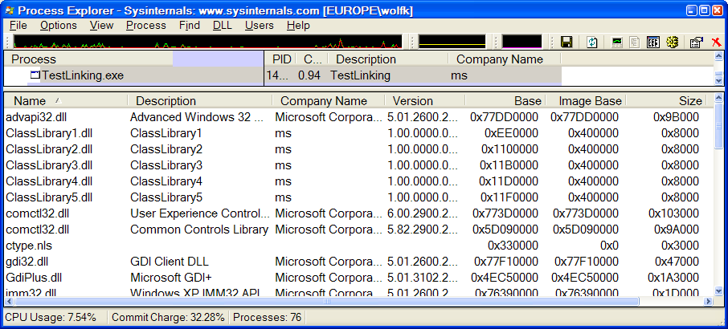
When to use Ngen?
If DLL used in several loaded processes
If multiple instances of application started e.g. Terminal Server
Be set the base address of your assemblies correctly
Rebasing DLL during load impacts perf & prevents sharing image

Slide 20
Reference
.NET Code Generation Blog
http://blogs.msdn.com/b/clrcodegeneration/
The Performance Benefits of NGen.
http://msdn.microsoft.com/en-us/magazine/cc163610.aspx
JIT ETW tracing in .NET Framework 4
http://blogs.msdn.com/b/clrcodegeneration/archive/2009/05/11/jit-etw-tracing-in-net-framework-4.aspx

